Slide 1
Enhanced Lane Detection for Autonomous Vehicles: A Comprehensive Pipeline with Averaging and Future Improvements

Slide 2
objective
The objective of this project is to implement a sliding window algorithm to improve curve detection, allowing the system to dynamically adapt to lane curvature.
Next Objective is Overcome shortcomings of the current lane detection pipeline, specifically in accurately identifying and tracking curved lanes, by incorporating advanced algorithms and detection mechanisms.
Finally, It Enhance the accuracy and reliability of lane detection for autonomous vehicles by refining existing methodologies and integrating new techniques to better handle varied driving scenarios and challenging road conditions.

Slide 3
ABSTRACT
Introduces a sophisticated pipeline for accurate lane identification and tracking in autonomous vehicle navigation systems, employing techniques such as color masking, region selection, Canny edge detection, Hough line transformation, and interframe averaging.
The pipeline demonstrates proficiency in detecting straight and slightly curved lanes, although it exhibits limitations in handling sharp turns and curvature.
Proposed improvements include the implementation of a sliding window algorithm for enhanced curve detection and the integration of vehicle and adjacent lane detection mechanisms.
The findings underscore the importance of continuous refinement to address evolving challenges in autonomous navigation and pave the way for future advancements in lane detection technology.

Slide 4
Literature survey
S.No | Title | Author | Contributions
1 | Lane Detection and Tracking Using a Cascaded CNN-Based Pipeline - IEEE | Zhang, Z., Wang, W., Wang, Y., & Wang, J | This work presents an end-to-end system for lane boundary identification, clustering and classification, based on two cascaded neural networks, that runs in real-time.
2 | Lane Detection and Classification for Forward Collision Warning Systems: An Efficient Deep Learning Approach-IEEE | Quoc-Cuong Pham, Junsik Kim, et al | This research presents an efficient deep learning approach for lane detection and classification in forward collision warning systems.

Slide 5
S.No | Title | Author | Contributions
3 | Multi-Task Learning for Lane Detection and Lane Type Classification using Deep Neural Networks- IEEE | Xuesong Shi, Haitao Zhao, et al. | This paper proposes a multi-task learning framework for lane detection and lane type classification using deep neural networks. By jointly optimizing lane detection and classification tasks, the proposed approach achieves improved performance in lane recognition
4 | Deep Learning Techniques for Lane Detection: A Review and Comparative Study | Shangfei Wang, Xingping Dong, et al. | This review paper provides a comprehensive overview and comparative study of deep learning techniques for lane detection in autonomous vehicles..

Slide 6
S.No | Title | Author | Contributions
5. | Deep Learning Techniques for Semantic Segmentation: A Comprehensive Survey- IEEE | X. Li, Y. Wang, et al. | This survey explores deep learning techniques for semantic segmentation tasks, emphasizing the use of CNNs. It discusses various network architectures, training strategies, and applications in semantic segmentation, providing insights into recent advancements in the field.
6. | Real-Time Lane Detection Using Deep Learning for Autonomous Vehicle Applications | Amirhossein Yazdani, Hamed Habibi Aghdam, et al. | This research presents a real-time lane detection method based on deep learning for autonomous vehicle applications, demonstrating high-speed and accurate lane detection using CNNs.

Slide 7
PROPOSED WORK
The proposed system incorporates a sliding window algorithm to enhance curve detection.
This algorithm will allow the system to dynamically adjust to the curvature of the lanes, ensuring accurate identification and tracking even in scenarios involving sharp turns.
To improve the vehicle's ability to localize itself within its surroundings, the proposed system includes mechanisms for detecting nearby vehicles and adjacent lanes.
This additional information contributes to a more comprehensive understanding of the road environment, enabling the vehicle to make informed decisions.

Slide 8
These enhancements aim to overcome the identified shortcomings in the current pipeline, particularly its limitations in handling curved lanes.
The sliding window algorithm provides a more dynamic approach to curve detection, while the integration of vehicle and adjacent lane detection mechanisms adds an additional layer of context awareness to the system.
The proposed system builds upon the current pipeline's strengths and addresses its limitations through the incorporation of advanced algorithms and detection mechanisms.
These improvements aim to create a more versatile and accurate lane detection system for autonomous vehicles.

Slide 9
MODULES
Module 0: Getting the Images - Completed
Module 1: Masking Unnecessary Colours - Completed
Module 2: Crop out the Region of Interest - Completed
Module 3: Apply Canny Edge Detection - Completed
Module 4: Compute the Hough Lines – Completed
Module 5: Overlaying the Image and the Lines - Completed
Module 6: Testing and Validation - Completed

Slide 10
MODULE 0: Getting the Images
Collecting Road Images: Begin by collecting a diverse set of road images. These images form the raw dataset for the lane detection algorithm and are crucial for ensuring that the algorithm can handle various lighting conditions, road types, and lane markings.
Loading Images into Memory: Utilize image processing libraries to read the collected road images from their storage location. This step involves loading these images into the program's memory, making them accessible for processing and analysis.
Systematic Organization: After loading, organize the images systematically in a list named imageList. This organization facilitates efficient processing, allowing for sequential access to each image for further steps in the lane detection pipeline.
Visual Inspection and Display: Implement a function, display_images(), to display the images. This visual inspection is essential for verifying the quality of the images loaded and to ensure that they are appropriate for the subsequent processing stages. It also aids in identifying any issues early in the pipeline.
Initial Preparation for Processing: This phase serves as the groundwork for the entire lane detection process, ensuring that the images are ready for the complex analyses and transformations that follow. It sets the stage for the detailed and computationally intensive steps of color filtering, edge detection, and line detection that constitute the core of the lane detection algorithm.

Slide 11
Module 1: Masking Unnecessary Colours
Color Space Conversion: Convert the images from RGB to HSL color space. This conversion is crucial as it allows for more effective filtering of colors based on hue, saturation, and lightness levels, which is particularly useful for isolating the colors of lane markings under various lighting conditions and against different road surfaces.
Applying Color Thresholds: Apply specific color thresholds to isolate white and yellow colors, which are commonly used for lane markings. This step involves creating masks that filter out all colors except the shades of white and yellow, significantly reducing the complexity of the image and focusing on the elements most relevant for lane detection.
Combining Masks: Combine the masks for white and yellow to create a single mask that retains only the lane markings while discarding other elements of the image. This combined mask is then applied to the original image, resulting in an image that highlights the lane lines more prominently against the road surface.
Enhancing Lane Line Visibility: The final outcome of this process is an image where the lane lines are significantly more visible, making it easier to apply further processing steps like edge detection and line detection. This enhanced visibility is key to the success of the subsequent stages in accurately detecting and mapping the lane lines on the road.

Slide 12
Module 2: Crop out the Region of Interest
Defining the Region of Interest: Identify and define a polygon that outlines the region of the image where lane lines are most likely to be found. This area typically focuses on the lower half of the image, where the road and lane markings are, and excludes the sky, vehicles, and other irrelevant scenery.
Applying a Mask: Use the defined polygon to create a mask that isolates the region of interest (ROI) from the rest of the image. This is achieved by setting the pixel values outside the ROI to zero, effectively blacking out all parts of the image that are not within the defined polygonal area.
Focusing on Lane Lines: By cropping out the ROI, the algorithm can focus solely on the area of the image that contains lane lines. This significantly reduces the amount of data to process and helps in avoiding false positives from objects outside the ROI, such as trees, buildings, or cars in adjacent lanes.
Optimizing Processing: This selective focus on the ROI not only improves the accuracy of lane detection by eliminating distractions but also enhances processing speed. It allows the algorithm to concentrate computational resources on analyzing and detecting lane lines within a confined area, making the detection process more efficient.

Slide 13
Module 3: Apply Canny Edge Detection
Conversion to Grayscale: Before applying Canny edge detection, the image is converted to grayscale to simplify the edge detection process. This conversion reduces computational complexity by focusing on intensity variations instead of color differences.
Gradient Calculation: Canny edge detection works by calculating the gradient (rate of intensity change) at each pixel in the grayscale image. This helps in identifying areas with high intensity changes, which are likely edges within the image.
Thresholding Edges: Two thresholds are used in Canny edge detection: a low threshold for detecting faint edges and a high threshold for detecting strong, pronounced edges. Pixels with gradients above the high threshold are considered edges, while those between the two thresholds are only considered edges if they are connected to strong edges.
Edge Thinning: Finally, the algorithm performs edge thinning to ensure that edges are sharp and not thick or blurred. This step helps in obtaining a cleaner and more precise representation of edges, which is crucial for accurately identifying lane lines.

Slide 14
Module 4: Compute the Hough Lines
Hough Transform Application: This step involves applying the Hough Transform technique to the edge-detected image to identify lines. The Hough Transform is a feature extraction method used to isolate features of a particular shape within an image, in this case, the straight lines of lane markings.
Line Detection Parameters: Set parameters for the Hough Transform that dictate how lines are detected, including the resolution of the Hough grid, the minimum number of votes (intersections in Hough space) a candidate line needs to have to be considered a line, and the minimum length and maximum gap of line segments to be joined into a single line.
Resulting Lines: The output is a collection of lines that represent the potential lane markings detected in the image. These lines are described by their end points and can be overlaid on the original image for visualization.

Slide 15
Module 5: Overlaying the Image and the Lines
Line Visualization: Overlay the detected Hough lines on the original road image to visualize the lane markings. This step involves drawing the lines, typically in a distinctive color, onto the original image to show where the algorithm has detected lane lines.
Image Blending: Use weighted sums to blend the original image with the one containing the detected lines. This ensures that the lines are visible on top of the original road image, making it easy to assess the accuracy of the line detection.
Final Visualization: The final image showcases the detected lane lines clearly against the road, serving as a direct visual confirmation of the detection's effectiveness and accuracy.

Slide 16
Module 6: Testing and Validation
Apply Pipeline to Test Images: Run the complete lane detection pipeline on a set of test images. This step is critical for initial testing and validation, allowing for the assessment of the pipeline's effectiveness across various road conditions and scenarios.
Performance Evaluation: Evaluate the accuracy and reliability of the lane detection by comparing the algorithm's output against manually marked lane lines or known outcomes. This can involve qualitative visual inspection or quantitative metrics.
Iterative Improvement: Based on the performance evaluation, iteratively adjust the parameters and techniques used at various stages of the pipeline. This continuous improvement process is crucial for optimizing the lane detection algorithm's accuracy and reliability across a wide range of driving conditions.

Slide 17
Results and discussion
The pipeline successfully identifies and highlights lane lines across a variety of road conditions, demonstrating its capability to distinguish between different types of lanes (e.g., solid, dashed) under varying lighting and weather conditions.
The incorporation of techniques like averaging lines over previous frames contributes to the stability and consistency of lane line detection in video streams, reducing jitter and enhancing the visual clarity of lane markings.
While effective in many scenarios, the pipeline faces challenges with sharp curves, varying road textures, and extreme weather conditions, indicating areas for future improvement and adaptation.
The results show promise for real-world applications, such as autonomous driving and driver assistance systems, though further testing and development are necessary to address the identified limitations and ensure robust performance in all driving environments.

Slide 18
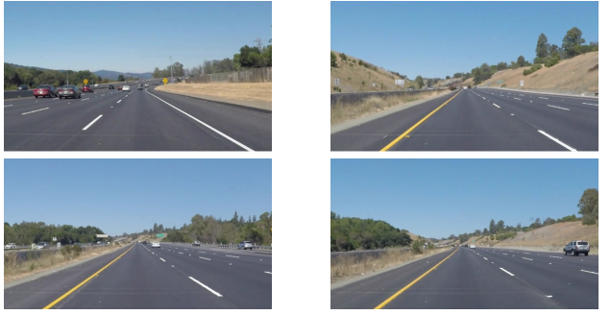
OUTPUT OF MODULES
Module 0: Getting the Images

Slide 19
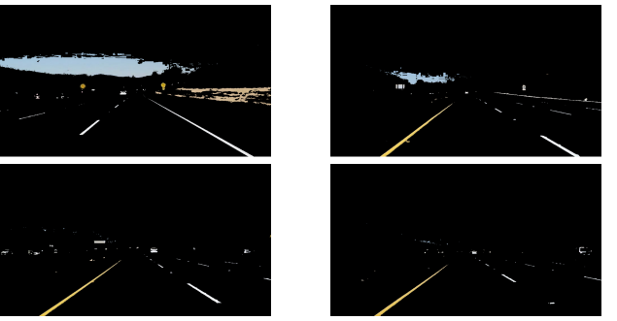
Module 1: Masking Unnecessary Colours

Slide 20
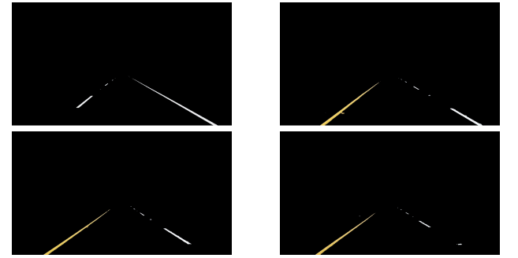
Module 2: Crop out the Region of Interest

Slide 21
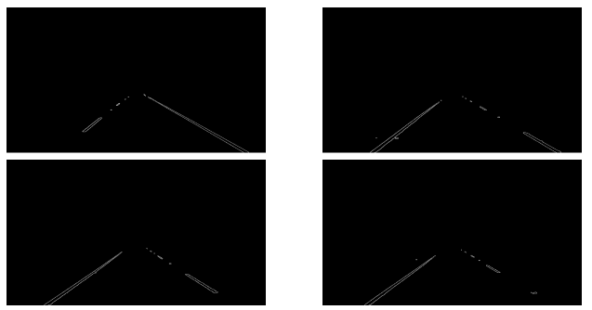
Module 3 : Apply Canny Edge Detection

Slide 22
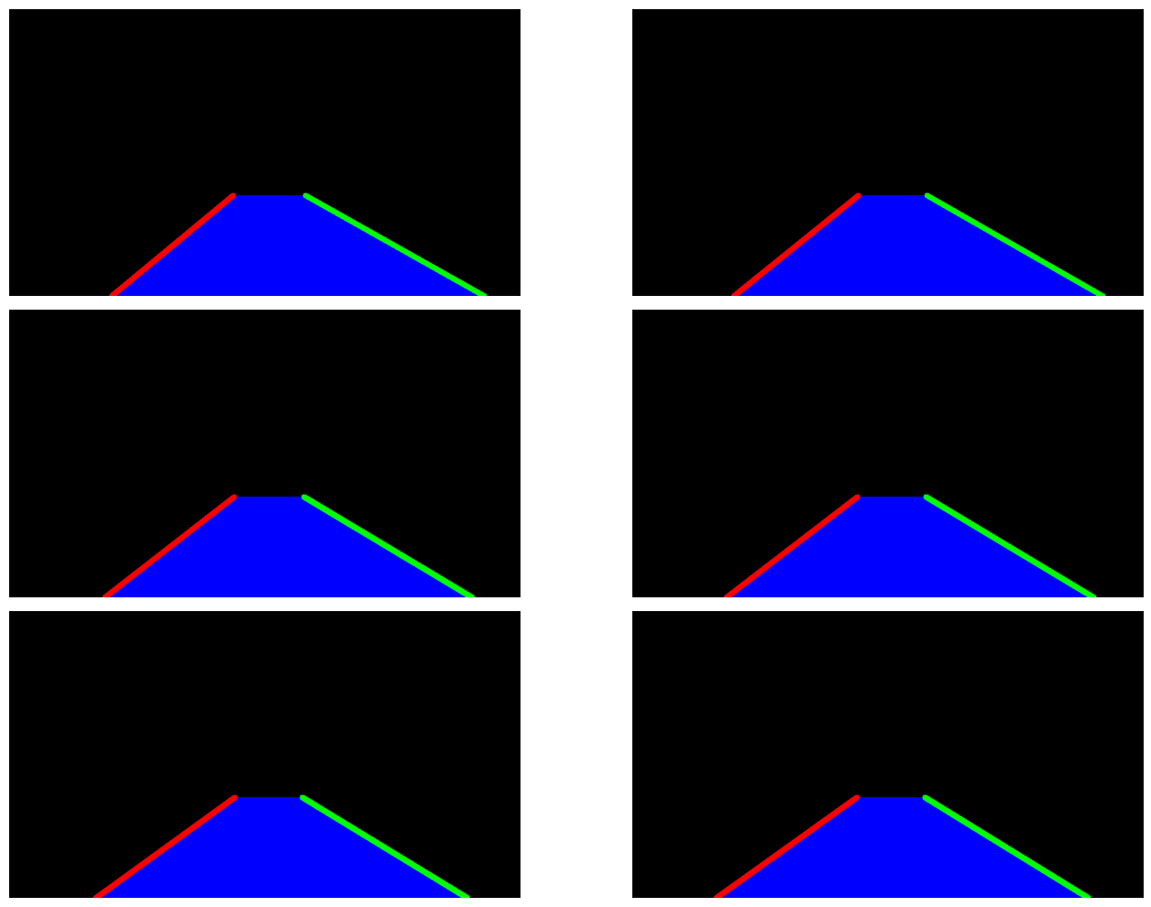
Module 4: Compute the Hough Lines

Slide 23
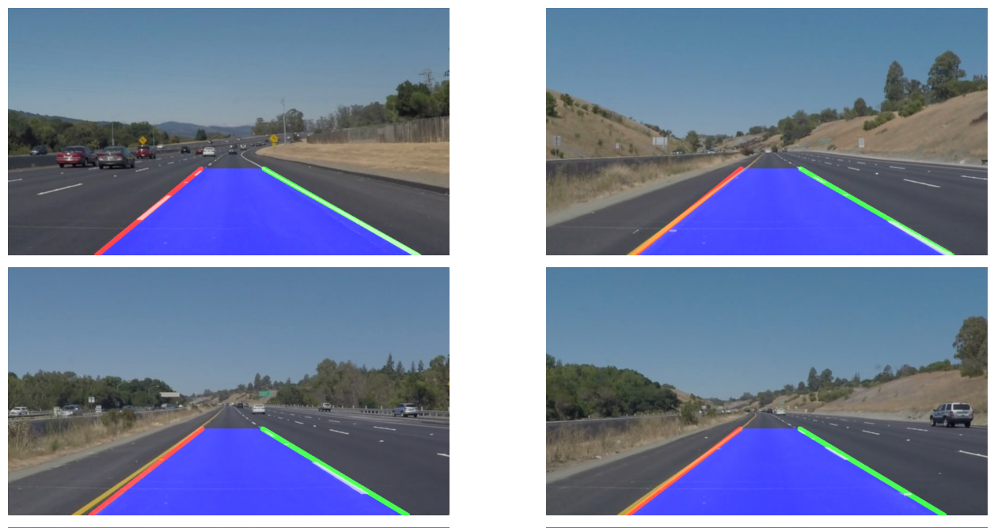
Module 5: Overlaying the Image and the Lines

Slide 24
Conclusion
In conclusion, the project successfully demonstrates a comprehensive pipeline for detecting lane lines on road images, utilizing techniques such as color masking, region of interest cropping, Canny edge detection, Hough Transform for line detection, and final image overlay for visualization. Testing and validation phases have highlighted the pipeline's effectiveness in identifying lane lines under various conditions, though with some limitations in handling highly curved lanes and variable lighting conditions. Future improvements could focus on enhancing the detection of curved lanes and robustness against environmental changes. This work lays a solid foundation for further exploration and development in the field of autonomous vehicle navigation and road safety technologies.

Slide 25
FUTURE ENHANCEMENT
Curved Lane Detection: Implement advanced algorithms such as polynomial regression or sliding window techniques to accurately detect curved lanes, improving the system's performance on winding roads and during sharp turns.
Dynamic Thresholding: Develop adaptive color and edge detection thresholds that adjust based on lighting conditions, weather, and road surface variations, enhancing the system's reliability across diverse driving environments.
Machine Learning Integration: Incorporate machine learning models, especially deep neural networks, to learn complex lane patterns and scenarios, offering significant improvements in detection accuracy and the ability to handle ambiguous lane markings.
Real-time Processing Enhancements: Optimize the algorithm for real-time processing capabilities, ensuring it can be effectively integrated into autonomous driving systems for live road navigation and safety applications.

Slide 26
REFERENCES
Canny, J. (1986). "A Computational Approach to Edge Detection." IEEE Transactions on Pattern Analysis and Machine Intelligence, 8(6), 679–698.
Duda, R. O., & Hart, P. E. (1972). "Use of the Hough Transformation to Detect Lines and Curves in Pictures." Communications of the ACM, 15(1), 11–15.
Chen, Y., Seet, G. G., & Do, M. N. (2015). "Robust Lane Detection and Tracking in Challenging Scenarios." IEEE Transactions on Intelligent Transportation Systems, 16(4), 1834–1849.
Zhao, Z., Wang, L., & Wang, L. (2018). An Improved Lane Detection Algorithm Based on Hough Transform and Morphological Operation. In 2018 3rd International Conference on Image, Vision and Computing (ICIVC) (pp. 756-760).
He, K., Zhang, X., Ren, S., & Sun, J. (2016). Deep residual learning for image recognition. In Proceedings of the IEEE conference on computer vision and pattern recognition (pp. 770-778).

Slide 27
THANK YOU

